Slide 1






Week: One Two Three Four Five Six
M
T
W
T
F
2 Mar
9 Mar
16 Mar
23 Mar
30 Mar
6 April
3 Mar
10 Mar
17 Mar
24 Mar
31 Mar
7 April
Ash
Weds
4 Mar
11 Mar
18 Mar
25 Mar
1 April
8 April
27 Feb
5 Mar
12 Mar
19 Mar
26 Mar
2 April
Maundy
Thurs
28 Feb
CAFOD
Fast Day
13 Mar
20 Mar
27 Mar
3 April
Good
Friday
Defending land and people in the Amazon
Easter
Sunday
Lent calendar 2020
Notes:
Each date on this slide is hyperlinked within the presentation. In Slide Show mode, click each date to go to that day’s content.

Slide 2
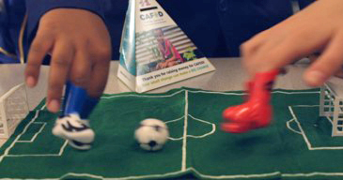
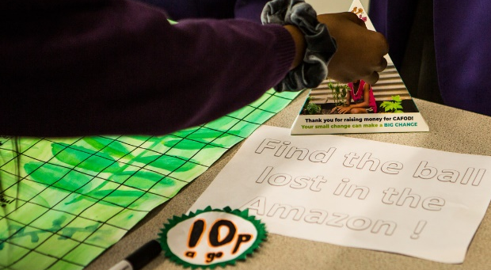
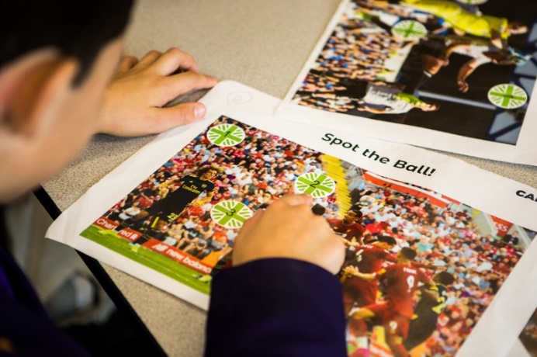
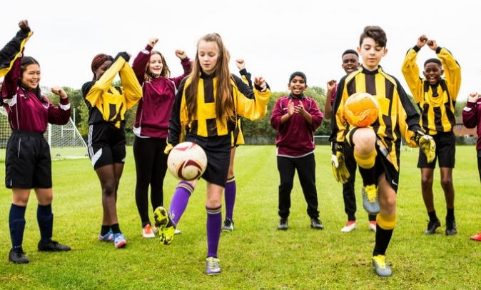



This Lent we’re challenging you to
Ash Wednesday 26 Feb
Will you do a football-themed fundraiser to support people defending their land and their homes?
Your fundraising can help some of the poorest, most remote communities defending their human rights.
In this calendar, you’ll find out more about Amazonian people who are being threatened.
Watch and share our Lent film and find out why we want to Defend the defenders.
Lord, help me to wear my ashes today with courage and as a witness. Amen
Notes:
Teachers: Our Lent resources are at cafod.org.uk/schools, including a Lent liturgy which can be used as your Ash Wednesday service.
You can contact your local CAFOD volunteer centre to ask for someone to speak or lead an assembly or workshop during Lent. Find details of your local centre at: cafod.org.uk/Volunteer/CAFOD-in-your-area

Slide 3
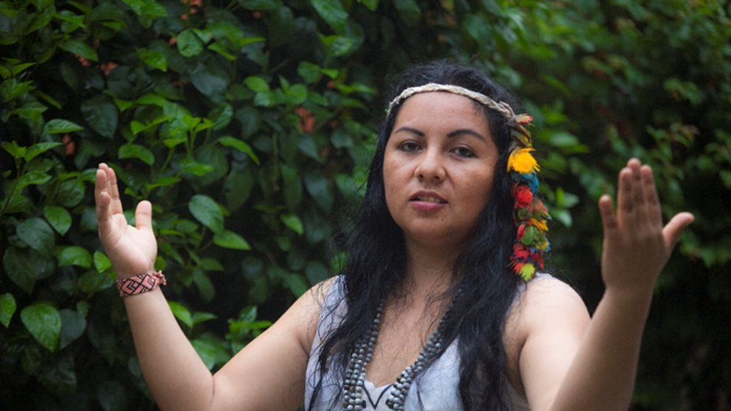
“...like a tree that is planted beside the flowing waters.”
Thursday 27 Feb
Psalm 1
Indigenous people, who have always cared for the Amazon, now see its trees being felled. Every minute more than a football pitch of forest is lost as outsiders take it to farm cattle, grow oil palms or soya, mine gold or drill for oil.
Yesica from Peru says: “Indigenous people do not see the forest as a million dollars but as their home, like a mother who gives them a blanket, like a mother​ who gives them life. It must,​ therefore, be defended.”
Watch our video about Yesica and Hector and start to plan your football-themed fundraising.
Lord, this Lent, give us the water of life to refresh our hearts and our world. Amen
Notes:
The video is downloadable from: cafod.org.uk/secondary/lent
If they have not already done so, please encourage your students to start planning their fundraising for Family Fast Day, 6 March. There are lots of ideas at the above webpage and in the Lent schools pack sent to your school in January.

Slide 4
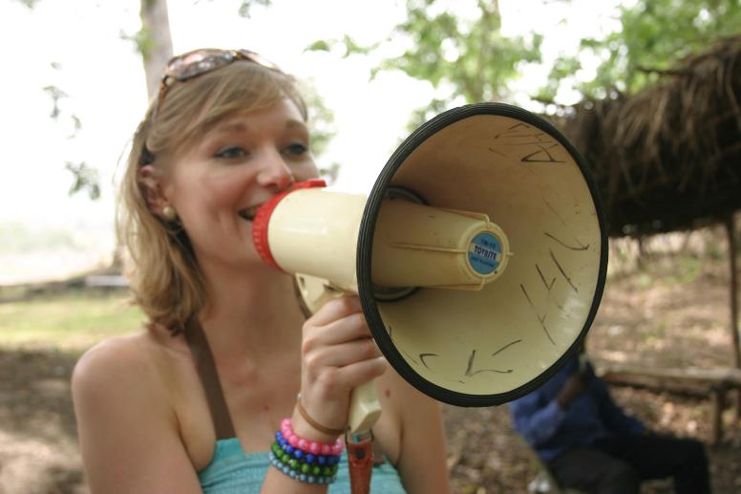
“Raise your voice like a trumpet.”
Isaiah 58
Friday 28 Feb
Isaiah, the prophet, shouts to the people all the ways they have not served God.
What injustices should I be shouting about?
Maybe today I can tell someone that people in the Amazon are losing their homes - and even their lives - as they defend their land.
Contact your local CAFOD volunteer centre to ask how you can speak in your parish.
Lord, give me courage to speak out whenever I see injustice. Amen
Notes:
Find details of your local CAFOD volunteer centre at: cafod.org.uk/Volunteer/CAFOD-in-your-area
There are short talks and other materials to help young people speak in public for CAFOD at cafod.org.uk/secondary

Slide 5
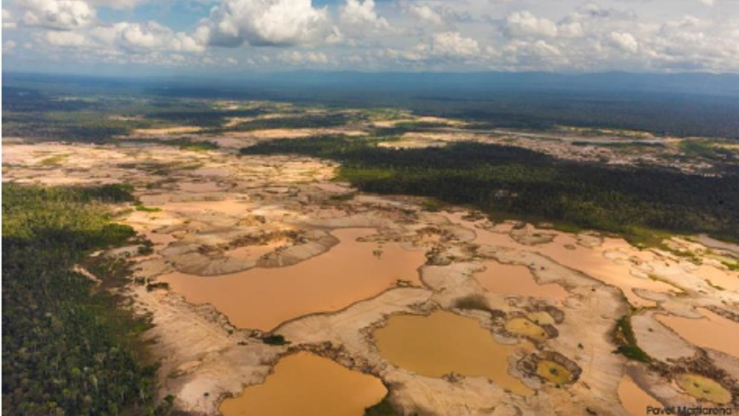
“…neither shall you gather the fallen grapes of your vineyard. You shall leave them for the poor…”
Monday 2 March
Saint David
Leviticus 19
In the Old Testament, farmers did not gather all their crop. They left some for the poorest people.
Amazonian people have centuries of expertise in living off the forest without harming it. Yet their forest is being lost.
How will you share Earth’s produce more fairly?
Identify five products that contain palm oil.
Much palm oil is grown on stolen Amazon land.
Lord, help us to share the Earth’s riches more fairly. Amen
Notes:
Use our prayer card for St David’s Day.

Slide 6
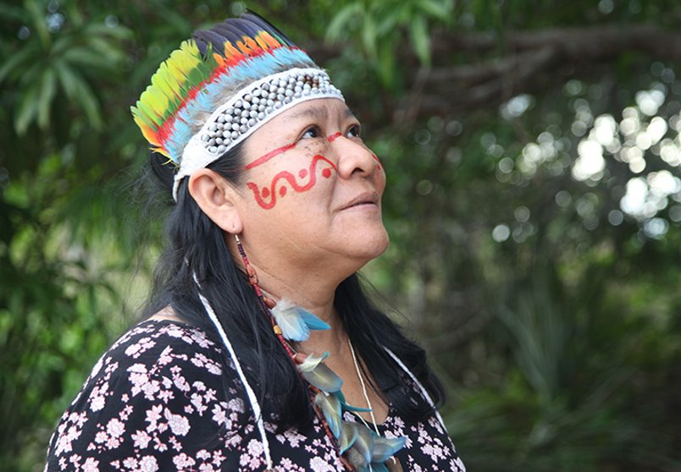
“The Lord is close to the broken-hearted.”
Tuesday 3 March
Psalm 33
Pope Francis says we must listen “to the cy of the earth and the cry of the poor”. Joênia Wapixana, the first indigenous lawyer in Brazil, did exactly this.
She led a legal action to compel Brazil’s government to protect indigenous land in northern Brazil. It took five years.
Finally, the Supreme Court confirmed the exclusive right of the indigenous people to occupy and use the land.
Look out for anyone who is sad today and say an encouraging word to them.
Lord, make me ready to listen to the broken-hearted. Give me wisdom and compassion. Amen

Slide 7
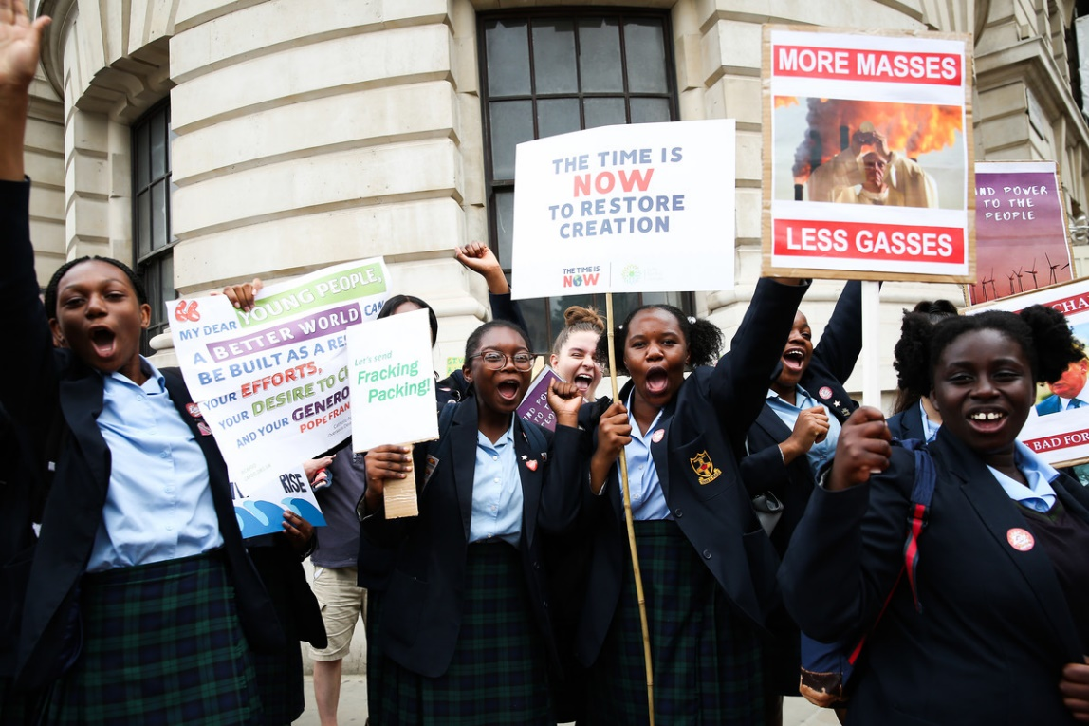
“And the people of Nineveh believed in God.”
Wednesday 4 March
Jonah 3:1-10
When Jonah spoke God’s message, the people of Nineveh believed him. They changed their attitude and their lifestyle.
God asks us to care for our planet and help protect its poorest people - the most affected by climate change.
How can we persuade others to believe this message?
Find a way to reduce waste today.
Creator God, help me to show how precious your creation is by the way I live. Amen.
Notes:
Picture credit: Eleanor Church

Slide 8
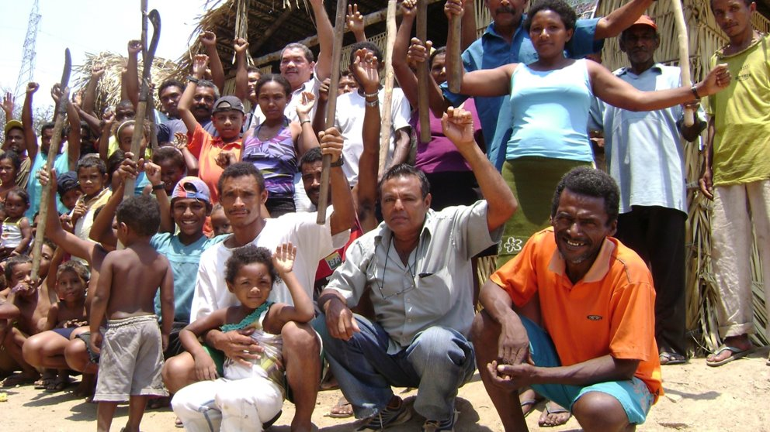
“On the day I called,
you answered me, O Lord.”
Thursday 5 March
Psalm 137
Encampment of Aras Santo Elias, Pará, Brazil.
In 2018 a legal ruling confirmed the families’ right to stay here.
Do I struggle on, trying to solve everything myself, or do I ask for help from God and from others?
Everyone needs help sometimes.
A team of lawyers supported by CAFOD has so far helped at least 80,000 families in the Amazon gain legal rights to land.
Now they have a safe place to live and grow food.
It’s Fairtrade Fortnight. Buy a Fairtrade product. Thank your local shop for stocking it.
Bring your needs and the needs of others to God in prayer today.
Notes:
Remind your class that tomorrow is Family Fast Day. Encourage them to visit our website for resources and decide how they will mark this special day.
You can find educational resources about Fairtrade at: cafod.org.uk/secondary/fairtrade
Picture credit: CPT (Pastoral Land Commission)

Slide 9

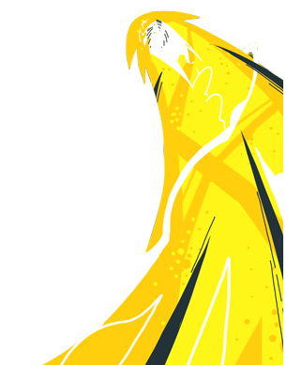
Friday 6 March
Today is CAFOD Lent Fast Day
“…come back and present your offering.”
Matthew 5:23-24
Many of God’s family live in extreme poverty due to conflict, injustice or the impacts of climate change.
Amazonian people are experiencing all three.
We can help change this by prayer, speaking out, living simply… and taking the challenge to fundraise this Lent!
Fast Day is a great day to hold or plan a football-themed fundraiser! See our website for ideas.
Lord, help me to work for a world where everyone has a fair share. Amen
Notes:
Go to our website for more Fast Day resources: cafod.org.uk/Education/Secondary-teaching-resources/Lent
As a prayer reflection today – your class could watch and read our illustrated version of Isaiah 58 about ‘true fasting’: cafod.org.uk/content/download/775/6458/file/Secondary__Isaiah-58_illustrations_liturgy.ppt

Slide 10
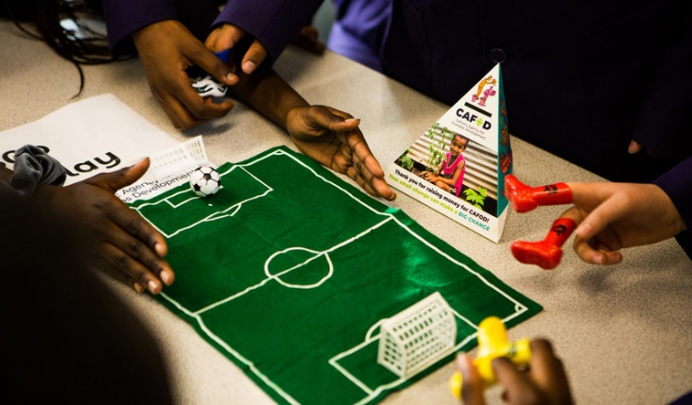
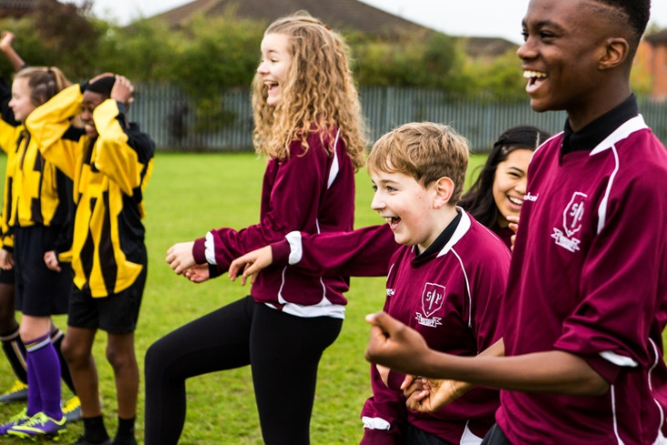
“Give and there will be gifts for you…”
Monday 9 March
Luke 6:36-38
We are called to be generous to others, just as God is generous to us. Many young people in England and Wales are doing this in Lent through football-themed fundraisers.
What are your gifts? Are you a musician, a team builder, a good listener...?
How can you be generous with your gifts?
Find a way to share one of your gifts today to help someone else.
Lord, open my hands to receive your gifts and share them with others. Amen
Notes:
Picture credits: Thom Flint

Slide 11
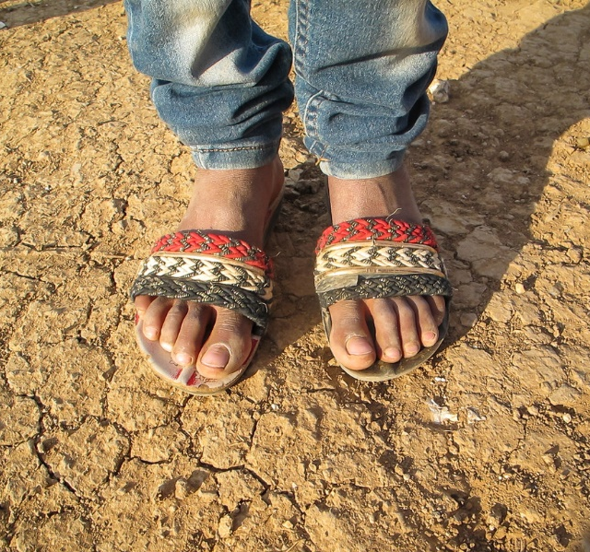
“The greatest among you must be your servant.”
Tuesday 10 March
Matthew 23:1-12
Jesus acted as a servant to the disciples when he washed their feet at the last supper. He said they must serve each other too.
But what does it mean to be a servant today?
This is the Year of the Word. Download a Bible app to your phone and read a verse or two daily.
Lord, help me to listen for your voice today. And to act on what you say to me. Amen

Slide 12
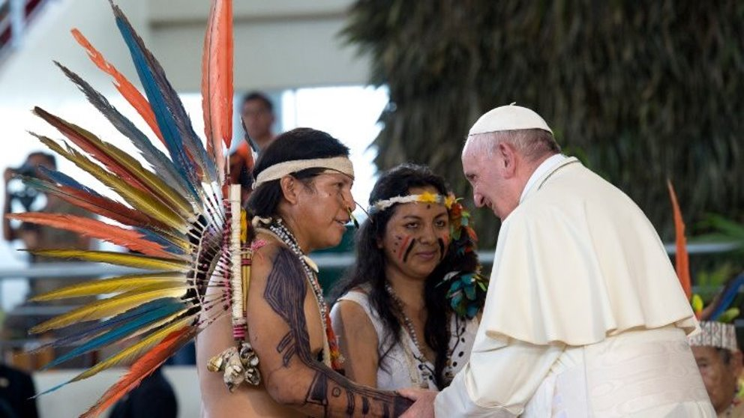
“I say, ‘You are my God…’”
Wednesday 11 March
Psalm 31
“The native Amazonian peoples have probably never been so threatened on their own lands as they are at present…
You are a living memory of the mission that God has entrusted to us all: the protection of our common home.
The defence of the earth has no other purpose than the defence of life.”
Pope Francis
Think of five ways you can defend life.
Lord, you are our God and the God of all creation. Help us to defend it from harm. Amen
Notes:
Pope Francis spoke these words when visiting Peru and its Amazonian peoples in January 2018.

Slide 13
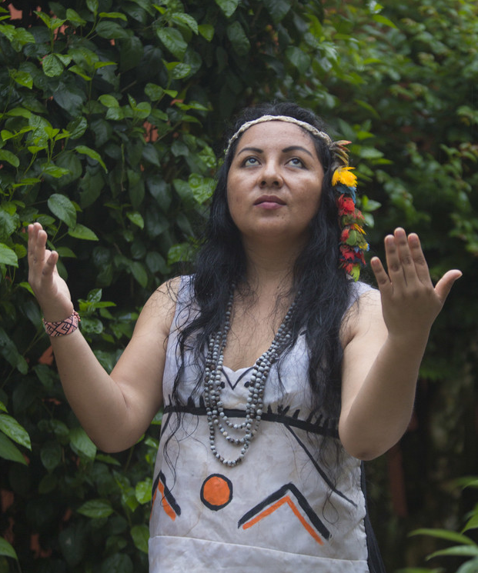
“At his gate there lay a poor man called Lazarus…” Luke 19:20
Thursday 12 March
Jesus told the story of the rich man and Lazarus. This story is still relevant: around one in ten people in our world lives in extreme poverty.
Yet the poorest have gifts to share and wisdom to teach.
Like Yesica, teacher and artist, who travelled with CAFOD support to be part of the Amazon Synod in Rome last year.
Watch this 3-minute film featuring Yesica.
Lord, thank you for the gifts you have given me to share with others. Amen
Notes:
If your class is still looking for ways to fundraise during Lent, there is an A-Z of ideas at: cafod.org.uk/secondary
Picture credit: Pavel Martiarena Huamán

Slide 14
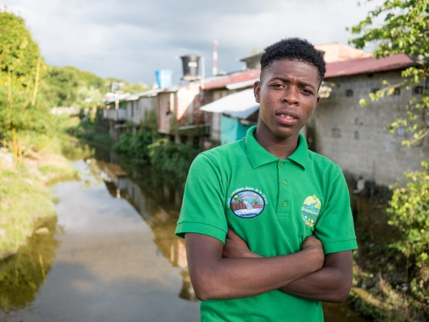
“They threw him into a pit. The pit was empty; there was no water in it.”
Friday 13 March
Genesis 37:24
Joseph’s brothers threw him down a dry well - one of the few times lack of water has been an advantage!
Around the world, lack of water is a growing problem.
Proto is in a group called ‘Young Guardians of the Atrato River’ in Colombia. They raise awareness of the importance of protecting the river and they clean the creek that runs into it.
Find out how you can support Proto and other climate defenders in prayer this year
We pray for those who protect the world’s water supplies. Move us to do the same, Lord. Amen
Notes:
Picture credit: Matts Olsson

Slide 15
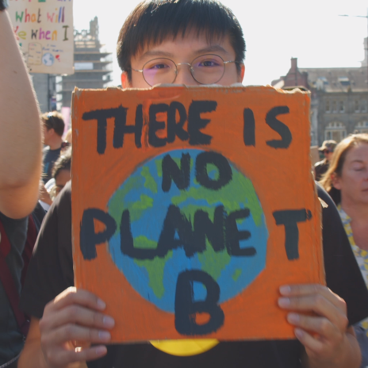
“The woman went back to the town and said to the people…”
Monday 16 March
John 4:28-29
The Samaritan woman told everyone about meeting Jesus by the well and what he had said to her.
When have you been bursting to share some news?
It is good news that this December world leaders meet in Glasgow to discuss how to tackle the climate emergency.
Find and share a good news statistic about progress on Sustainable Development Goals.
Pray with us today, and all this year, for defenders of the climate.

Slide 16
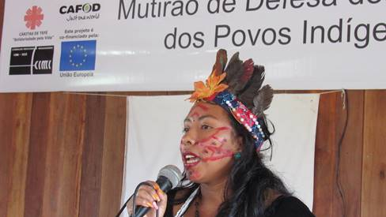
“Lord, teach me your paths…”
Tuesday 17 March
Psalm 24
We all need good teachers, both in school and in life. Other people, and our experiences, help us to grow.
Wanem says her community was manipulated into selling their trees. But she says, thanks to a training programme supported by CAFOD: “…we now have a much better understanding of our rights and know we can go after whatever we need to help us to guarantee them”.
Wanem from the Brazilian Amazon
Tonight, take a minute to look back and see what you have learned.
Lord, thanks for the chance to learn. Help me to be open to what you teach me today. Amen.

Slide 17
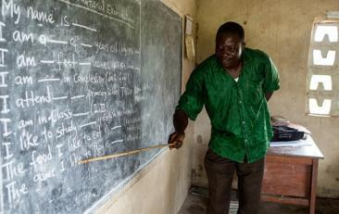
“Whoever keeps these commandments and teaches them will be considered great in the kingdom of heaven.”
Wednesday 18 March
Matthew 5:17-19
Using my skills is great. But if I teach two others a skill today and they teach two others tomorrow, who teach two more the next day… by the tenth day, 1024 people will have learned that skill. (Do the maths!)
If we lead by example, we can change the world.
Show others - face to face or on social media - how they can help protect the Amazon.
Divine Teacher, show me how to teach your ways by word and example. Amen

Slide 18
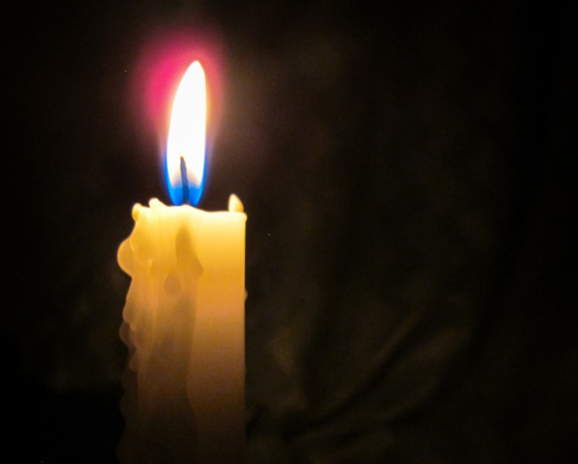
“When Joseph awoke, he did as the angel of the Lord had commanded him”
Thursday 19 March
Saint Joseph
Matthew 1:16, 18-21, 24
We may not see angels, even in our dreams. But God still wants to speak to us. Lent is a good time to make more space to listen.
How is God speaking to me today?
This is the Year of the Word. Download a bible app to your phone and read a verse or two daily.
Lord, help me to listen for your voice today. And to act on what you say to me. Amen

Slide 19
“You must love your neighbour as yourself...”
Friday 20 March
International Day of Happiness
Mark 12:28-34
Who do I consider to be my neighbour?
Pope Francis says: “Each of us is responsible for his or her neighbour: we are our brothers’ and sisters’ keepers, wherever they live.”
How can I love my neighbour who is far away?
Lawyers supported by CAFOD helped families gain a legal ruling giving the right to stay in Aras Santo Elias, Pará, Brazil.
Think of ten reasons, not connected to consuming, to be happy today.
Rejoice today… and look out for God!

Slide 20
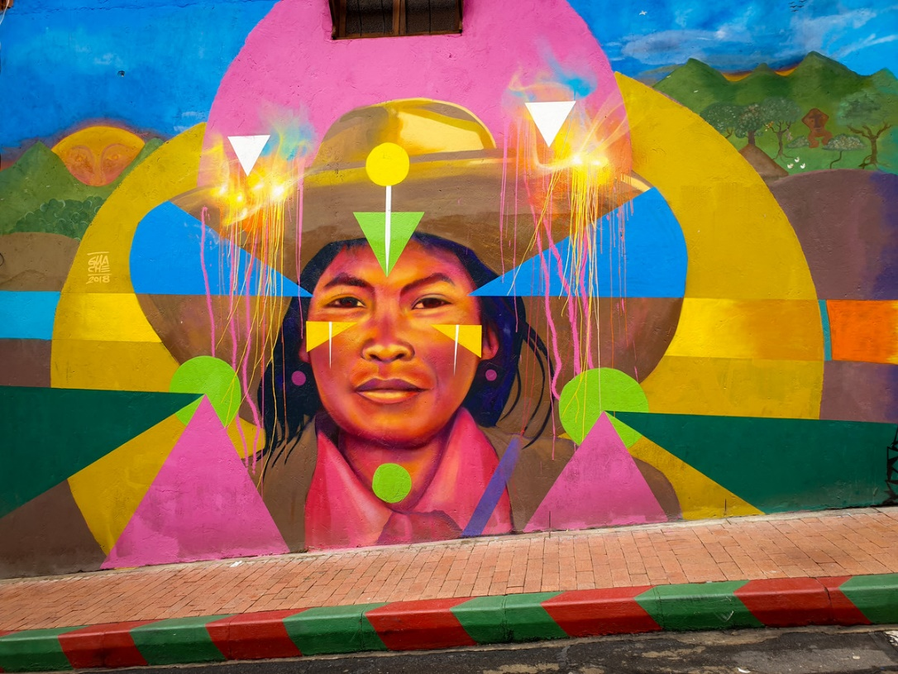
“They will build houses and inhabit them…”
Monday 23 March
Isaiah 65:17-21
Amazonian people who build a house may have it taken from them as big companies grab their land to mine for gold, graze cattle or farm soya or palm oil.
Pope Francis called the Earth “our common home”.
What is it that makes the place you live “home”?
Street art in Colombia
To show that you appreciate your home, tidy or clean a bit of it!
Lord, thanks for my home. Bless everyone who does not have a safe home to live in. Amen
Notes:
Picture credit: Sally Kitchener

Slide 21
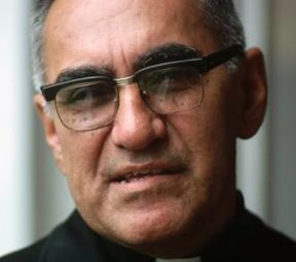
“The Lord of hosts is with us; the God of Jacob is our stronghold.”
Tuesday 24 March
Saint Oscar Romero
Psalm 45
Saint Oscar Romero’s feast is today. Like the writer of today’s psalm, Romero looked on God as his stronghold. God gave him courage to defend the poorest people, despite death threats.
Many people in the Amazon and around the world receive death threats because they stand up for human rights – like the right to a safe place to live.
Am I brave enough to stand up for justice?
Watch and share our Romero video.
Pray one of the Stations of the Cross.
Notes:
You can find the Stations at: cafod.org.uk/secondary/lent

Slide 22
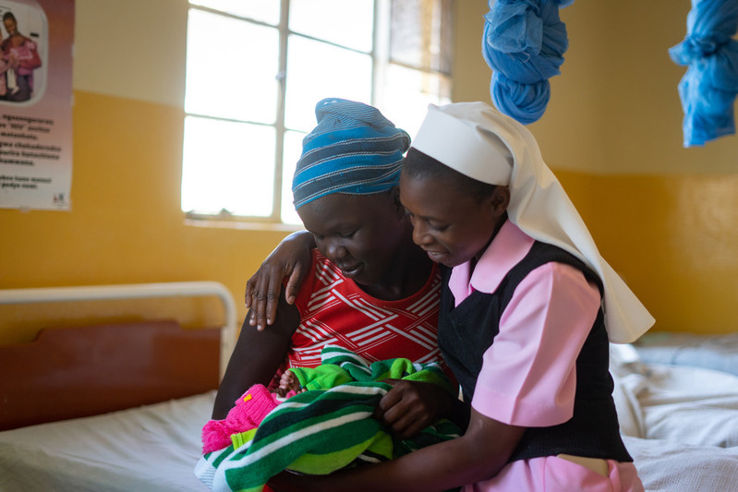
“Rejoice, so highly favoured!”
Wednesday 25 March
The Annunciation
Luke 1:26-38
Mary was reassured by the angel that she need not be afraid about giving birth to Jesus.
Sister Consilia told us that expectant mothers sometimes arrive at her hospital in Zimbabwe with no food for themselves or clothes for their baby.
She, the other sisters and the hospital staff reassure the women. She says: “We never turn women away.”
Watch our film for parishes to find out more about Sister Consilia’s work.
Lord, help me to reassure those who are afraid. Amen

Slide 23
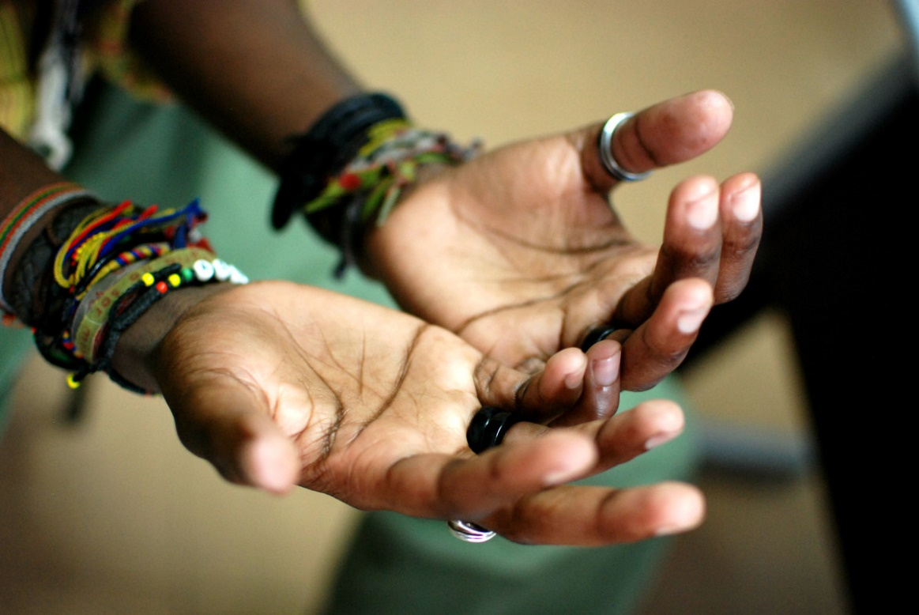
“They have made themselves a calf of molten metal and have worshipped it…”
Thursday 26 March
Exodus 32:7-14
As Moses talked to God on the mountain, his people were worshipping a golden calf.
Gold mining contaminates land and rivers in the Amazon and people lose their land to big corporations. Some who protest are even killed. Is a precious metal as precious as people’s lives?
What do I consider most precious in my life?
Watch Hector from the Amazon explaining that lives are more valuable than gold.
Lord, help me to be centred on you and on the things that really matter. Amen
Notes:
**Reminder: please return the contents of collection boxes and envelopes to CAFOD at the end of term.**

Slide 24
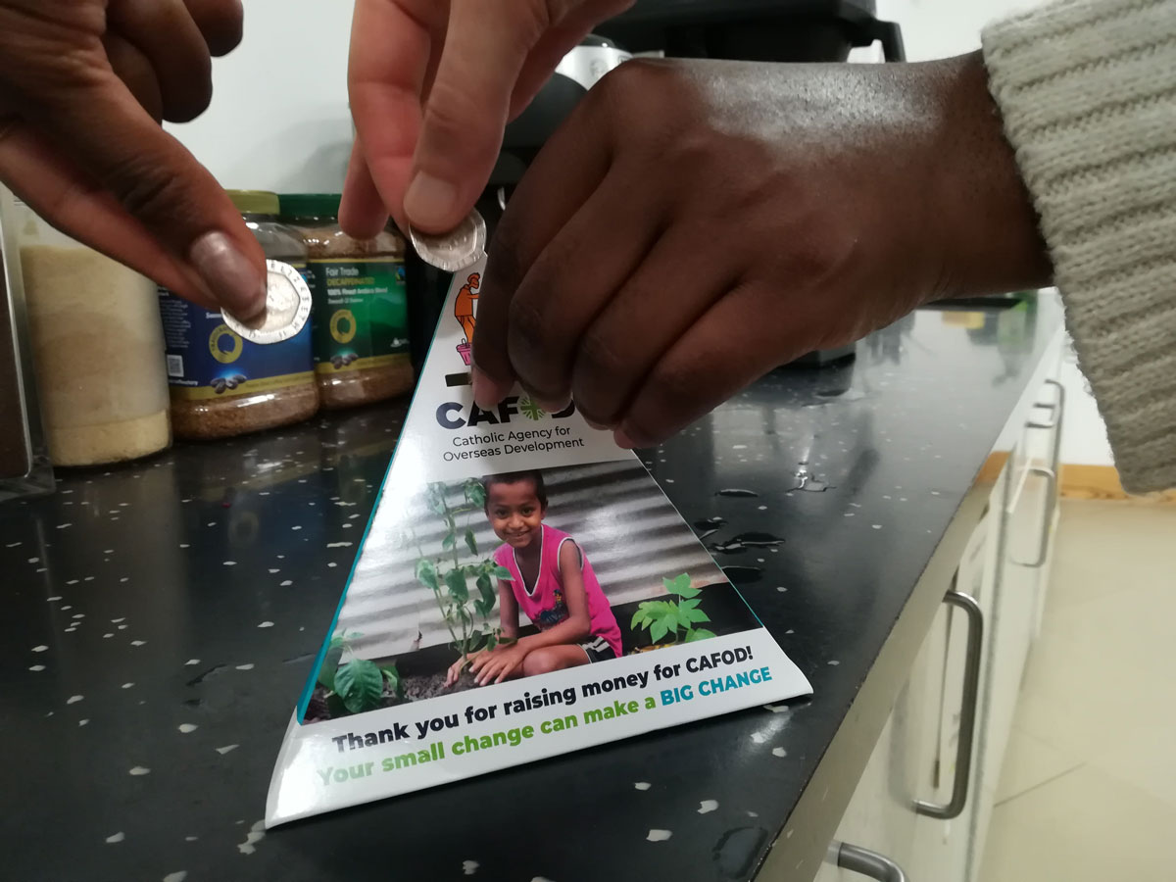
“His way of life is not like others’, the paths he treads are unfamiliar.” Wisdom 2:15
Friday 27 March
Today’s reading says that people who are trying to live as God wants will stand out as different. Yet we’re bombarded with adverts that tell us to look like this, act like that or buy this product in order to fit in.
Do I have the courage to live differently, to challenge our consumer-driven society?
Standing up for the poorest is different! Get sponsored to raise money for Lent.
Lord, you created each person as unique. Help me to treasure my difference. Amen.

Slide 25
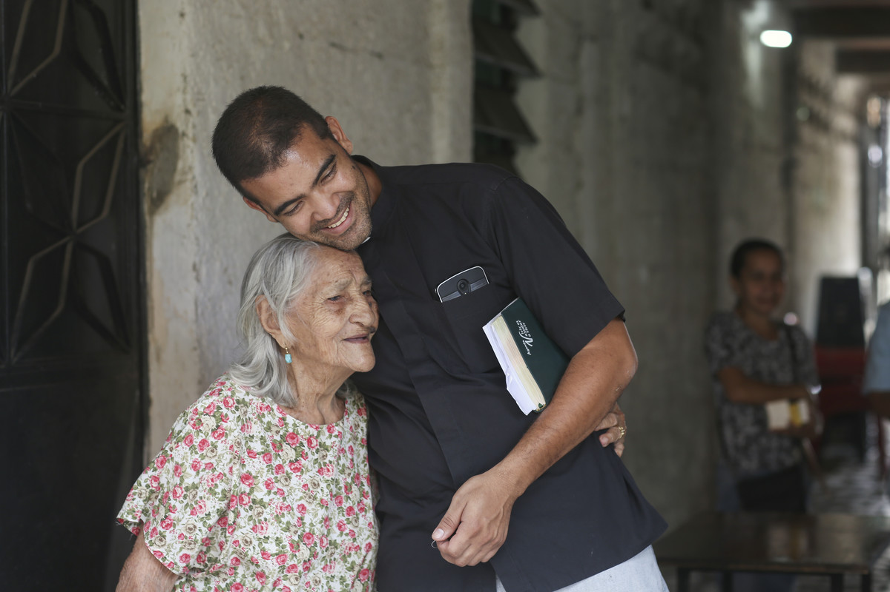
“You judge by appearances, but I do not judge anyone.”
Monday 30 March
John 8:12-20
If, like Jesus, we are rooted in love, our natural response to others is not to judge but to have compassion. When we see suffering, we just have to respond.
Compassion is one of the values that underpin CAFOD’s work. Which values underpin your life?
Decide the three values that matter most to you.
Lord, help me never to condemn anyone. Amen.
Notes:
Our core values, cafod.org.uk/About-Us/CAFOD-Catholicism, may spark some ideas.
Picture credit: Caritas Internationalis

Slide 26
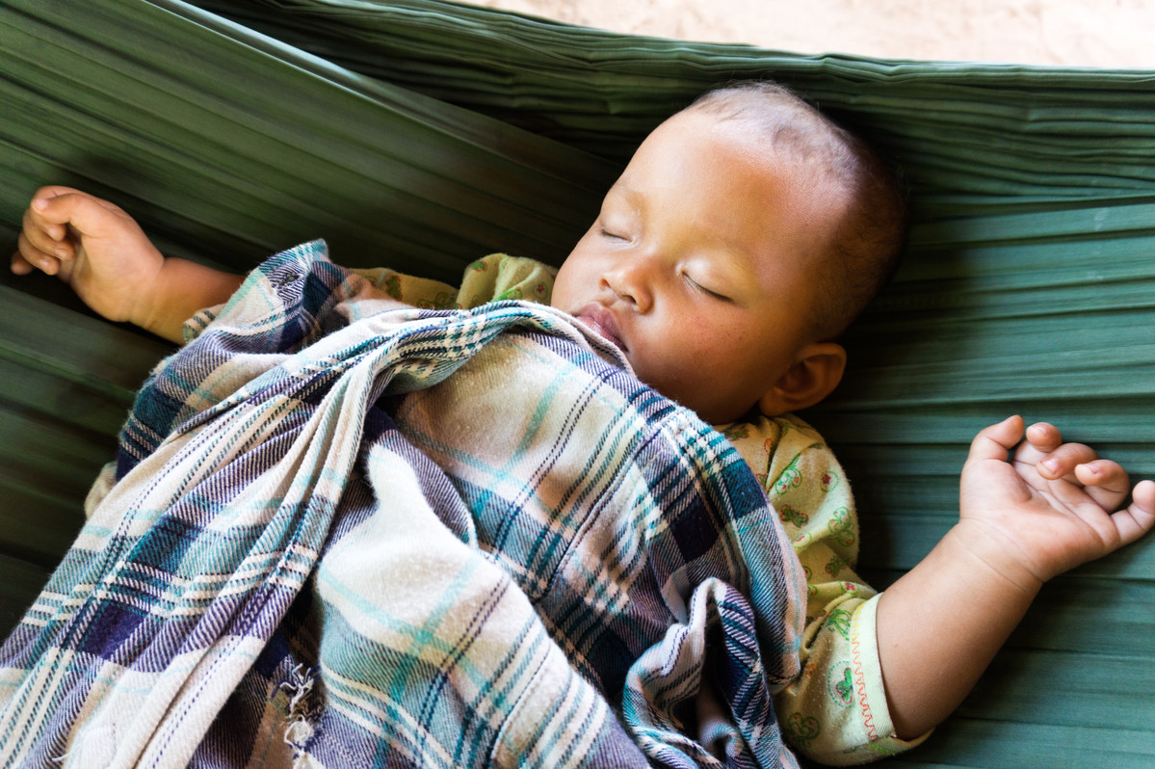
“Do not hide your face from me...”
Psalm 101
Tuesday 31 March
The psalm today invites us to seek God’s face.
The face of God is all around us, in those who act for justice and peace, in those who choose to love and in every person. We are all made in God’s image.
Do I recognise God’s face in those around me?
Try to spot the face of God at least three times today.
Lord, show me your face. Amen
Notes:
Picture credit: Chloe Sideserf

Slide 27

“He has sent his angel to rescue his servants…” Daniel 3
Wednesday 1 April
The Book of Daniel tells a story of God rescuing three men from a fiery furnace. We may not face a furnace, but the criticism of others can sometimes seem as bad.
From what do I want God to rescue me?
Small actions make a difference. Do a kind act today.
God of the impossible, help me to trust you. Amen
Notes:
Picture credit: Tonya Christner from FreeImages

Slide 28
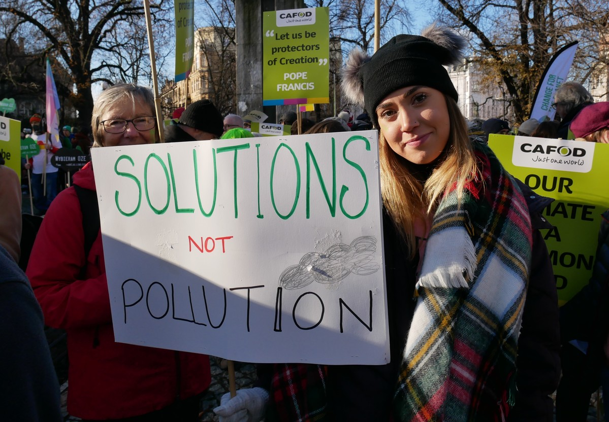
“Here now is my covenant with you: you shall become the father of a multitude of nations.”
Thursday 2 April
Genesis 17:3-9
God made a covenant with Abraham and he became father of many generations.
What kind of covenant are we making with the Earth? How will the next generations remember us?
Our choices today can promise them a healthy planet.
Ask an older person: For what would you most thank your grandparents’ generation?
Lord, may future generations remember my own with a blessing. Amen.
Notes:
Encourage pupils to create a space where people can pray for the world, our environment and everyone we share it with. Put objects, photos and other reminders of creation’s beauty around the space.
Picture credit: Rosie Heaton

Slide 29
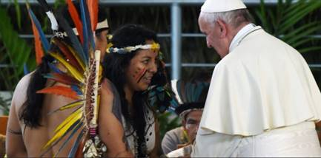
“The waves of death rose about me…”
Friday 3 April
Psalm 17:2-7
“Extractive oil, gas, gold companies, those who open roads saying they will bring development, see the forests as their warehouse… the indigenous people do not see the forest as a million dollars but as their home. Therefore, it must be defended.”
“We want to… tell humanity that we are worried. What are we doing to our home? What are we doing to the earth?”
Yesica, from the Harakbut indigenous community, speaking to Pope Francis
Speak up! Choose a phrase from our film of Yesica to share on social media.
Lord, open our ears to hear the cry of the earth and the cry of the poor. Amen
Notes:
Picture credit: Caritas Internationalis

Slide 30
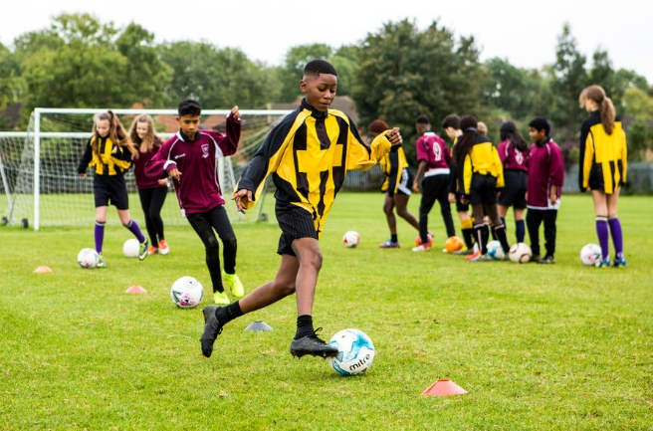
“Faithfully he brings true justice.”
Monday 6 April
International Day of Sport for Development and Peace
Isaiah 42:1-7
As the Body of Christ, it’s our calling to continue Jesus’ mission and bring true justice to the world.
This Lent, schools have done football fundraisers to support communities in the Amazon and make the world a more just place.
Thank you!
Tell us what you’ve done so we can inspire others: schools@cafod.org.uk or tag @CAFOD
Jesus, you were “good news to the poor”. May I be good news too. Amen
Notes:
See what other schools have been doing for Lent: cafod.org.uk/Education/Your-stories

Slide 31
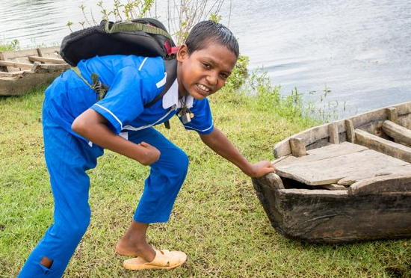
“I will be with you only a little while longer…”
Tuesday 7 April
World Health Day
John 13:21-38
You may remember Rabiul from Bangladesh, whose story
we shared last Lent.
We are sorry to have to share the news that, a few months ago, Rabiul died of a fever.
Our local experts will continue to help his parents and will support them through this difficult time in any way they can. Please keep them in your thoughts and prayers.
Eternal rest grant to him, O Lord. May he rest in peace.
Amen
Say or do something kind for someone you have hurt.
Lord, I pray today for the health of our world and all its people. Amen.

Slide 32
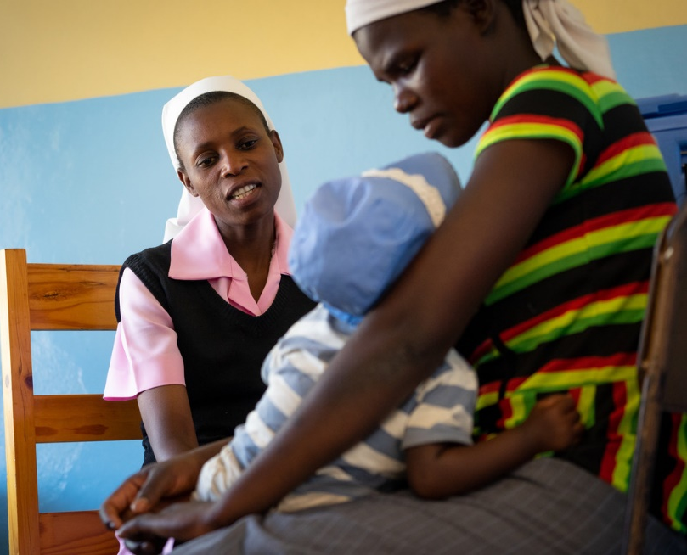
“I have reached the end of my strength.”
Wednesday 8 April
Psalm 68
Daily around the world people reach the end of their strength: women exhausted after carrying water for miles; farmers whose crops fail; children without enough food or medicine.
Thanks to your fundraising, experts in our global network support people at the end of their strength and help them to find a way forward.
Put some money into your Lent collection and, as Easter approaches…
…make plans to send it in to us.
Notes:
Teachers: Please collect and return your pupils' donations using the return form sent to your school in your Lent schools pack. If this is not possible, please mark the envelope 'Lent'. Thank you.
Picture credit: Zinyange Auntony

Slide 33
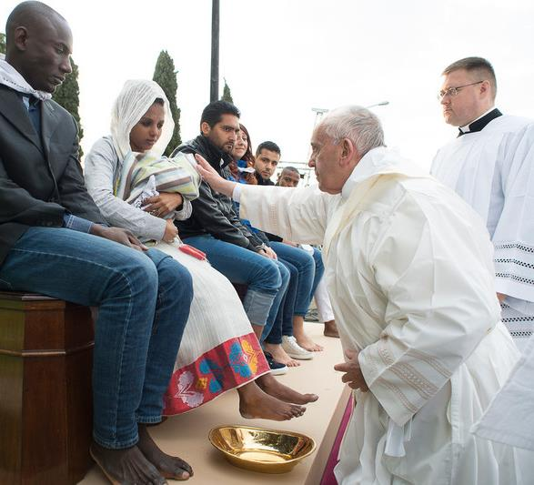
“This is my body…
do this as a memorial of me.”
Maundy Thursday 9 April
1 Corinthians 11:23-26
Taking part in the eucharist commits us to serve others. Jesus makes this clear in today’s gospel as he washes the disciples’ feet before the Last Supper.
Pope Francis said: “In the eucharist the Lord makes us walk on his road, that of service.”
Do I let the eucharist motivate me to serve others?
Do an act of service for someone else today without being asked.
When I receive you in Communion, Lord, move me to serve others. Amen
Notes:
Pope Francis blessing a child refugee at the washing of the feet on Maundy Thursday 2016.
Picture credit: L'Osservatore Romano

Slide 34
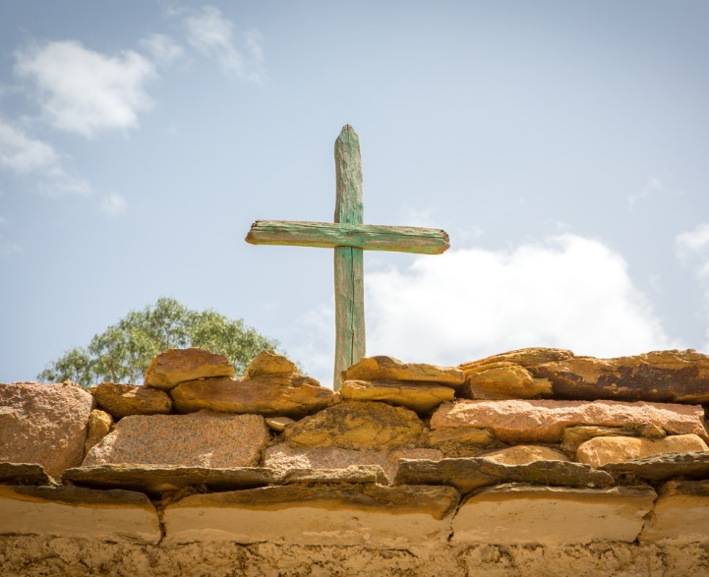
“They crucified him with two others, one on either side...”
Good Friday 10 April
John 18:1 - 19:42
Even as he was dying, Jesus spoke with the repentant thief and gave him hope.
It is not easy to show compassion all the time; it takes courage, determination and commitment.
Draw the outline of a cross. Write on it the names of people you know who are suffering and in need of hope. Include the Amazonian people.
Pray for them at 3pm, the hour Jesus died.

Slide 35

“This day was made by the Lord;
we rejoice and are glad.”
Easter Sunday 12 April
Psalm: 117
We often limit our expectations of God. But the Lord who can rise from the dead can do more than we can ever imagine.
Let’s rejoice today with our Lord who has conquered death and entrust our world and all its people to his care.
Jesus is alive! Alleluia!
Eat a Fairtrade egg, sing an Easter ‘Alleluia’ and celebrate Jesus alive in yourself and others today.
Notes:
Picture credit: Jeremy Doorten

